Slide 1
Numerical Computing Faculty: Adnan Ullah Khan College of Computing & Information Science Lecture :01

Slide 2

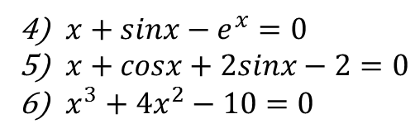

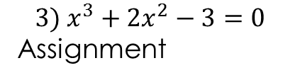
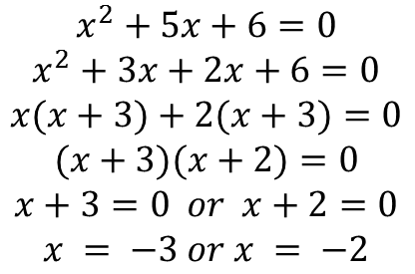
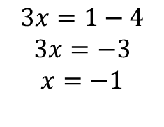
Why Numerical Computing
Review from mathematics
Some basic problem
Solution of equation
$$1) 3x+4=1$$
$${3) x}^{3}+2x^{2}−3=0$$
Assignment
$$3x=1−4$$
$$3x=−3$$
$$x=−1$$
$x+sinx−e^{x}=0$
$x+cosx+2sinx−2=0$
$x^{3}+4x^{2}−10=0$
$${2) x}^{2}+5x+6=0$$
$$x^{2}+5x+6=0$$
$$x^{2}+3x+2x+6=0$$
$$x(x+3)+2(x+3)=0$$
$$(x+3)(x+2)=0$$
$$x+3=0 or x+2=0$$
$$x = −3 or x = −2$$

Slide 3
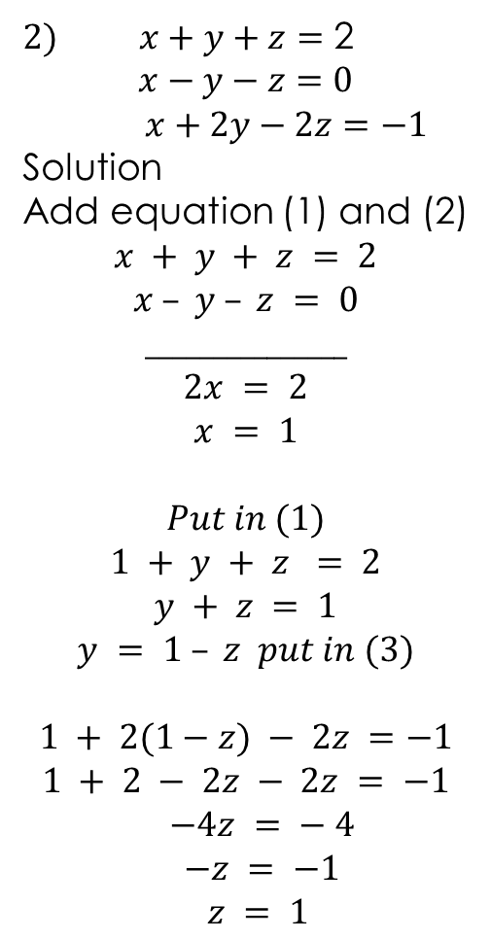
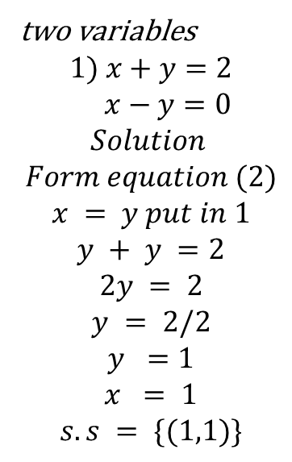
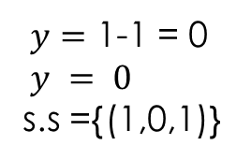
Why Numerical Computing
$2) x+y+z=$ 2
$$x−y−z=0$$
$x+2y−2z=−1$
Solution
Add equation (1) and (2)
$$x + y + z = 2$$
$$x – y – z = 0$$
$$_______________$$
$$2x = 2$$
$$x = 1$$
$$Put in (1)$$
$$1 + y + z = 2$$
$$y + z = 1$$
$$y = 1 – z put in (3)$$
$$1 + 2(1−z) − 2z =−1$$
$$1 + 2 − 2z − 2z = −1$$
$$−4z = − 4$$
$$−z = −1$$
$$z = 1$$
$y=$ 1-1 = 0
$y = 0$
s.s ={(1,0,1)}
Review form mathematics
Some basic problem
b) System of liner equation
two variables
$$1) x+y=2$$
$$x−y=0$$
$$Solution$$
$$Form equation (2)$$
$$x = y put in 1$$
$$y + y =2$$
$$2y = 2$$
$$y = 2/2$$
$$y =1$$
$$x = 1$$
$$s.s = \{(1,1)\}$$

Slide 4
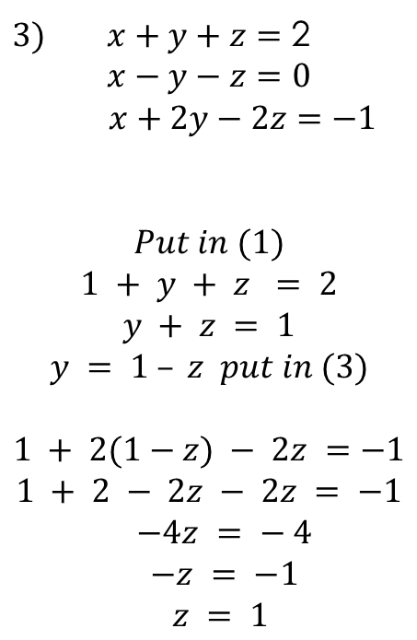
Why Numerical Computing
Review form mathematics
Some basic problem
b) system of liner equation
$3) x+y+z=$ 2
$$x−y−z=0$$
$x+2y−2z=−1$
$$Put in (1)$$
$$1 + y + z = 2$$
$$y + z = 1$$
$$y = 1 – z put in (3)$$
$$1 + 2(1−z) − 2z =−1$$
$$1 + 2 − 2z − 2z = −1$$
$$−4z = − 4$$
$$−z = −1$$
$$z = 1$$
$y=$ 1-1 = 0
$y = 0$
s.s ={(1,0,1)}

Slide 5
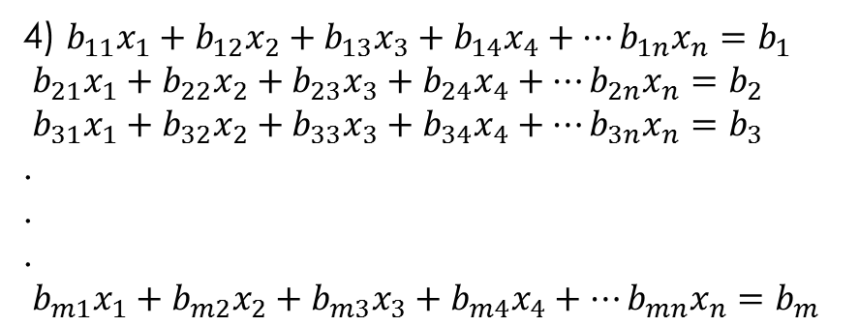
Why Numerical Computing
Review form mathematics
Some basic problem
b) System of liner equation
4) $b_{11}x_{1}+b_{12}x_{2}+b_{13}x_{3}+b_{14}x_{4}+…b_{1n}x_{n}=$ $b_{1}$
$b_{21}x_{1}+b_{22}x_{2}+b_{23}x_{3}+b_{24}x_{4}+…b_{2n}x_{n}=$ $b_{2}$
$b_{31}x_{1}+b_{32}x_{2}+b_{33}x_{3}+b_{34}x_{4}+…b_{3n}x_{n}=$ $b_{3}$
.
.
.
$b_{m1}x_{1}+b_{m2}x_{2}+b_{m3}x_{3}+b_{m4}x_{4}+…b_{mn}x_{n}=$ $b_{m}$

Slide 6

Why Numerical Computing
Review form mathematics
Some basic problem
c) system of Non liner equation
$x^{2}+y^{2}=5$
$$x^{2}−y^{2}=3$$
Solution
Add (1) & (2)
$$x^{2}+y^{2}=5$$
$$x^{2}−y^{2}=3$$
$${2x}^{2}=8$$
$$x^{2}=4$$
$$x=2$$
Put in to (1)
$$2^{2}+y^{2}=5$$
$4+y^{2}=5$
$y^{2}=5−4$
$$y=1$$

Slide 7
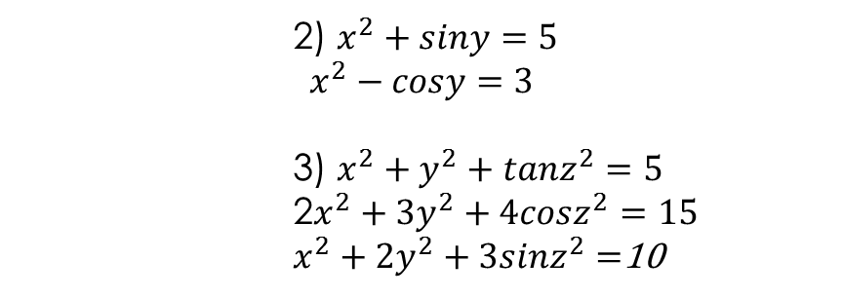
Why Numerical Computing
Review form mathematics
c) system of Non liner equation
2) $x^{2}+siny=5$
$$x^{2}−cosy=3$$
3) $x^{2}+y^{2}+tanz^{2}=5$
2$x^{2}+{3y}^{2}+4cosz^{2}=15$
$x^{2}+{2y}^{2}+{3sinz}^{2}=$10

Slide 8

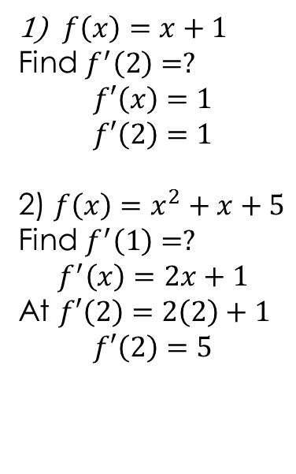
Why Numerical Computing
Review form calculus
d) Differentiation f’(x)
$f\left(x\right)=x+1$
Find $f^{′}\left(2\right)=?$
$$f′\left(x\right)=1$$
$$f′\left(2\right)=1$$
2) $f\left(x\right)=x^{2}+x+5$
Find $f^{′}\left(1\right)=?$
$$f^{′}\left(x\right)=2x+1$$
At $f′\left(2\right)=2\left(2\right)+1$
$$f′\left(2\right)=5$$
3) $f\left(x\right)=xsin\left(x\right)+cosx^{x^{x}}$
Find $f^{′}\left(2\right)=?$

Slide 9
Lecturer # | Topic
1 | Introduction/Review of Algebra/Review of Calculus/Why Numerical Computing/ course outline
2 | Solution of equation of one variable The Bisection Method Implementation on computer (Java/Mathlab/Excel)
3 | i) Fixed point Iteration Methods ii) Newton’s Method iii)Implementation on computer (Java/Mathlab/Excel)
4 | i) The Secant Methods ii) Method of False Position (Regula Falsi) iii) Implementation on computer (Java/Mathlab/Excel)
5 | i) Zeros of Polynomials and Müller’s Method ii) Horner’s Method iii) Implementation on computer (Java/Mathlab/Excel)
6 | Interpolation and Polynomial Approximation i) Interpolation and the Lagrange Polynomial ii) Data Approximation and Neville’s Method
7 | i)Divided Differences ii)Hermite Interpolation (optional) iii)Cubic Spline Interpolation (optional) iv) Parametric Curves (optional)

Slide 10
Lecturer # | Topic
8 | Numerical Differentiation forward-difference formula backward-difference formula Three-Point Formulas five-Point Formulas Second Derivative
9 | Implementation on computer (Java/Mathlab/Excel)
10 | Numerical Integration numerical quadrature The Trapezoidal Rule Simpson’s Rule Implementation on computer (Java/Mathlab/Excel)
11 | Simpson’s Three-Eighths rule Composite Numerical Integration Implementation on computer (Java/Mathlab/Excel)
12 | i)Romberg Integration ii)Gaussian Quadrature iii)Implementation on computer (Java/Mathlab/Excel)
13 | i)Romberg Integration ii)Gaussian Quadrature iii)Implementation on computer (Java/Mathlab/Excel)

Slide 11
14 | Initial-Value Problems for Ordinary Differential Equations The Elementary Theory of Initial-Value Problems i) Euler’s Method ii) Higher-Order Taylor Methods
15 | i) Runge-Kutta Methods ii) Error Control and the Runge-Kutta-Fehlberg Method iii) Multistep Methods iv)Adams-Bashforth technique v) Adams-Moulton technique
16 | i) Predictor-Corrector Methods ii) Higher-Order Equations and Systems of Differential Equations
17 | Direct Methods for Solving Linear Systems (optional)
18 | IterativeTechniques in Matrix Algebra i) Eigenvalues and Eigenvectors (optional) ii)The Jacobi and Gauss-Siedel Iterative Techniques

Slide 12
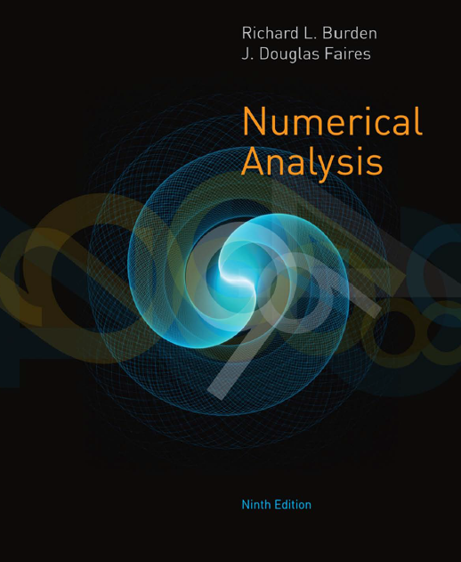
The recommended text for the course is the book: t
Title: Numerical Analysis
Authors: Richard L. Burden, John D. Faires
Edition: 9 or any other (should be same in class )
Publisher: Cengage Learning, 2011ext for the course is the book:

Slide 13
Please be on time.
Please pay attention

Slide 14
Solutions of Equations in One Variable
The Bisection Method
Suppose f is a continuous function defined on the interval [a, b], with f (a) and f (b) of opposite sign. The Intermediate Value Theorem implies that a number p exists in (a, b) with f ( p) = 0. Although the procedure will work when there is more than one root in the interval (a, b), we assume for simplicity that the root in this interval is unique. The method calls for a repeated halving (or bisecting) of subintervals of [a, b] and, at each step, locating the half containing p.
To begin, set a1 = a and b1 = b, and let p1 be the midpoint of [a, b]; that is,
p1 = a1 +( b1 − a1)/2
= (a1 + b1)/2.
• If f ( p1) = 0, then p = p1, and we are done.
• If f ( p1) = 0, then f ( p1) has the same sign as either f (a1) or f (b1).
• If f ( p1) and f (a1) have the same sign, p ∈ ( p1, b1). Set a2 = p1 and b2 = b1.
• If f ( p1) and f (a1) have opposite signs, p ∈ (a1, p1). Set a2 = a1 and b2 = p1.
Then reapply the process to the interval [a2, b2].

Slide 15
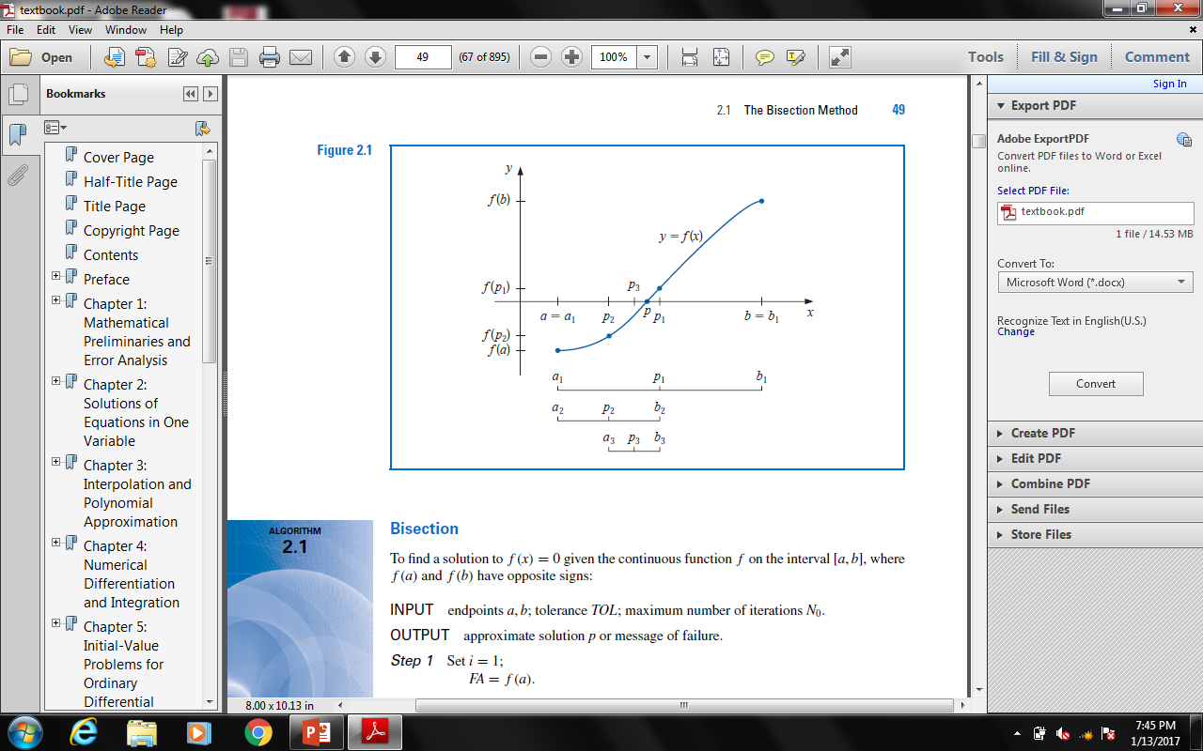
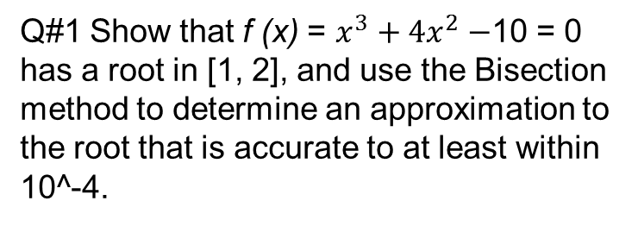
Q#1 Show that f (x) = $x^{3}+{4x}^{2}−$10 = 0 has a root in [1, 2], and use the Bisection method to determine an approximation to the root that is accurate to at least within 10^-4.
n an bn pn f ( pn)
1 1.0 2.0 1.5 2.375
2 1.0 1.5 1.25 −1.79687
3 1.25 1.5 1.375 0.16211
4 1.25 1.375 1.3125 −0.84839
5 1.3125 1.375 1.34375 −0.35098
6 1.34375 1.375 1.359375 0.09641
7 1.359375 1.375 1.3671875 0.03236
8 1.359375 1.3671875 1.36328125 −0.03215
9 1.36328125 1.3671875 1.365234375 0.000072
10 1.36328125 1.365234375 1.364257813 −0.01605
11 1.364257813 1.365234375 1.364746094 −0.00799
12 1.364746094 1.365234375 1.364990235 −0.00396
13 1.364990235 1.365234375 1.365112305 −0.00194

Slide 16

Theorem
Q#1 Determine the number of iterations necessary to solve f (x) = x^3 + 4x^2 − 10 = 0 with accuracy 10^-3 using a1 = 1 and b1 = 2.
Solution We will use logarithms to find an integer N that satisfies
| pN − p| ≤ (2^-N)(b − a)
2^-N < 10^-3.
Logarithms to any base would suffice, but we will use base 10 logarithms because the tolerance is given as a power of 10. Since 2^-N < 10^-3 implies that
log10 2^-N < log10 10^-3 = −3,
we have
−N log10 2 < −3
and
N >3/log10 2
≈ 9.96.
Hence, ten iterations will ensure an approximation accurate to within 10^-3.

Slide 17
Use the Bisection method to find p3 for f (x) = √x − cos x on [0, 1].
2. Let f (x) = 3(x + 1)(x − 1/2 )(x − 1). Use the Bisection method on the following intervals to find p3.
a. [−2, 1.5] b. [−1.25, 2.5]
3. Use the Bisection method to find solutions accurate to within 10^-2 for x^3 − 7x^2 + 14x − 6 = 0 on each interval.
a. [0, 1] b. [1, 3.2] c. [3.2, 4]
4. Use the Bisection method to find solutions accurate to within 10^-2 for x^4 − 2x^3 − 4x^2 + 4x + 4 = 0 on each interval.
a. [−2,−1] b. [0, 2] c. [2, 3] d. [−1, 0]
5. Use the Bisection method to find solutions accurate to within 10−5 for the following problems.
a. x − 2^-x = 0 for 0 ≤ x ≤ 1
b. e^x − x^2 + 3x − 2 = 0 for 0 ≤ x ≤ 1
c. 2x cos(2x) − (x + 1)^2 = 0 for −3 ≤ x ≤ −2 and −1 ≤ x ≤ 0
d. x cos x − 2x^2 + 3x − 1 = 0 for 0.2 ≤ x ≤ 0.3 and 1.2 ≤ x ≤ 1.3
6. Use the Bisection method to find solutions, accurate to within 10^-5 for the following problems.
a. 3x − e^x = 0 for 1 ≤ x ≤ 2
b. 2x + 3 cos x − e^x = 0 for 0 ≤ x ≤ 1
c. x^2 − 4x + 4 − ln x = 0 for 1 ≤ x ≤ 2 and 2 ≤ x ≤ 4
d. x + 1 − 2 sin πx = 0 for 0 ≤ x ≤ 0.5 and 0.5 ≤ x ≤ 1

Slide 18
7.Use Theorem, to find a bound for the number of iterations needed to achieve an approximation with accuracy 10^-3 to the solution of x^3+x−4 = 0 lying in the interval [1, 4]. Find an approximation to the root with this degree of accuracy.
8. Use Theorem, to find a bound for the number of iterations needed to achieve an approximation with accuracy 10^-4 to the solution of x^3−x−1 = 0 lying in the interval [1, 2]. Find an approximation to the root with this degree of accuracy.

